Slide 1
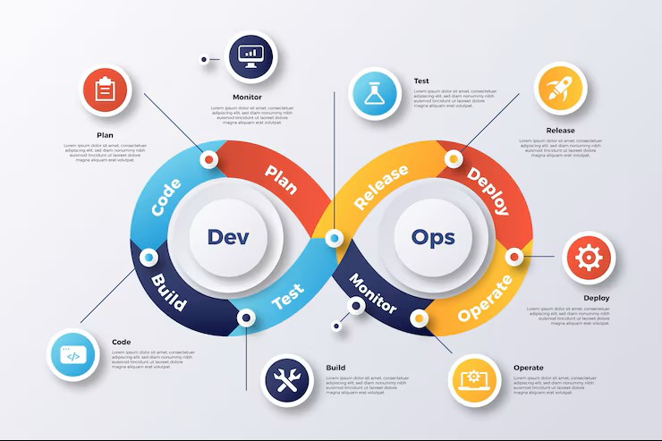
Software Development Life Cycle (SDLC)
The Software Development Life Cycle (SDLC) is a structured framework that guides the entire software project, from initial concept to deployment and ongoing maintenance. It ensures a systematic approach, enhancing product quality, controlling costs, and streamlining development processes.
This documentation explains the SDLC in a clear and structured manner, incorporating additional practical details such as environments (QA, Staging, UAT, PPE, Production) and the flow shown in the provided image.

Slide 2
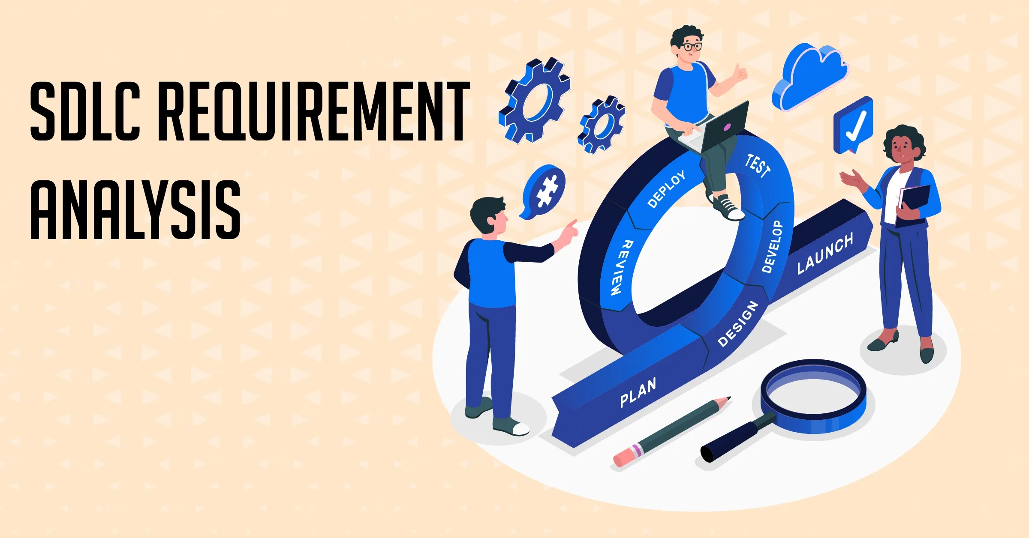

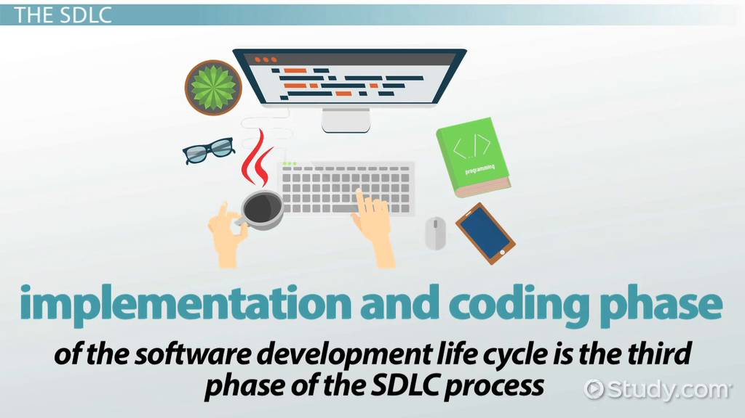
Key Stages: From Concept to Code
1. Planning & Requirements
2. Technical Design Phase
3. Implementation (Coding)
This foundational stage involves defining the project's scope, objectives, and gathering detailed user needs. Feasibility studies are conducted to assess technical, operational, and economic viability.
Architects and designers create a comprehensive blueprint for the system. This includes defining software architecture, database design, module specifications, and user interface (UI/UX) layouts.
Developers write the actual code based on the design specifications. This phase also includes unit testing each component to ensure it functions as intended before integration.

Slide 3

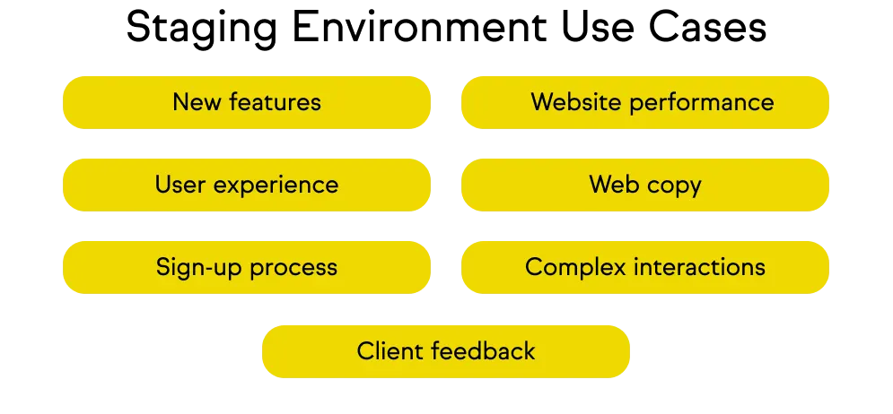
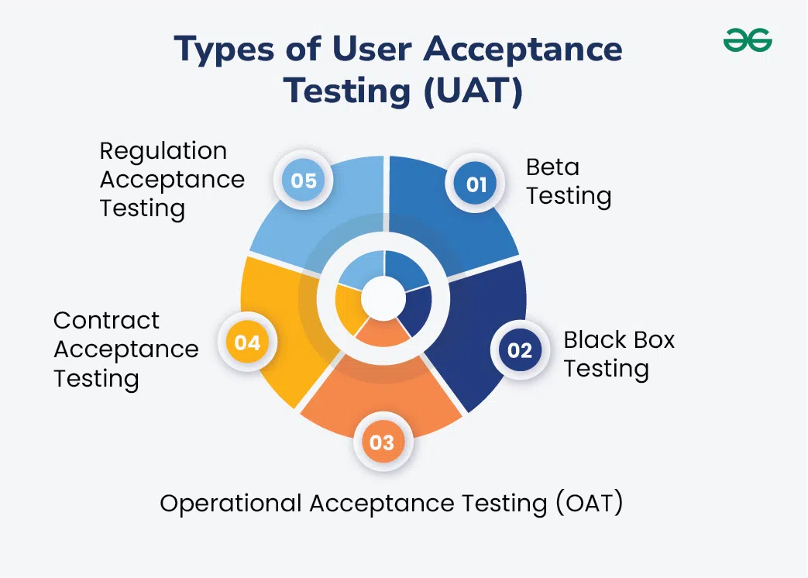
4. The Testing Phase
5. Staging Environment
6. User Acceptance Testing (UAT)
Rigorous examination to identify defects, ensure functionality, performance, and security. Crucial for software quality.
A replica of the production environment where final tests occur, ensuring compatibility and stability before deployment.
End-users validate the software against business requirements in a realistic setting, confirming it meets their needs.

Slide 4

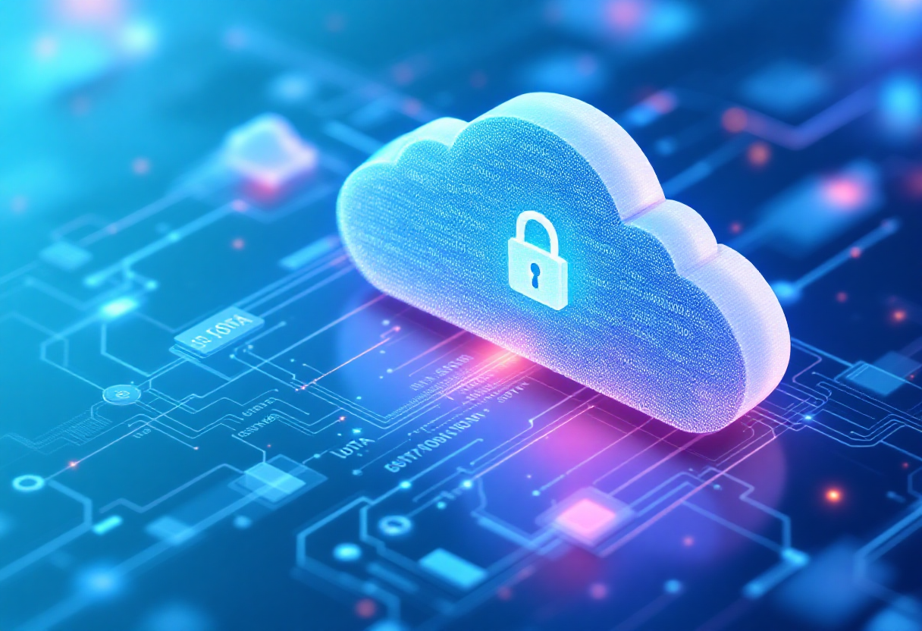
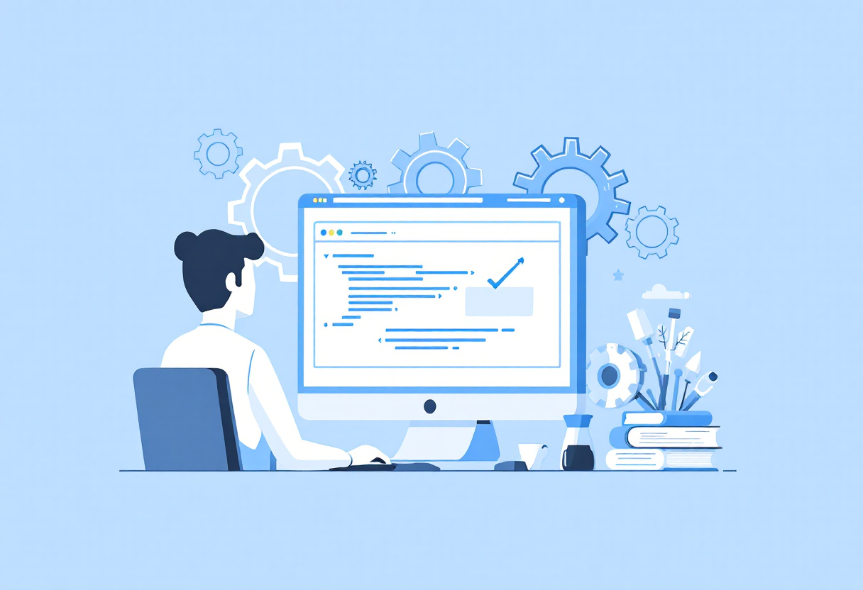
7. Pre-Production Environment (PPE)
8. Production Environment (PE)
9. Maintenance Phase
The PPE environment is a final testing stage before going live.
Final round check.
Ensuring there are no critical bugs.
This is the final phase of the SDLC.
Deploying the software to the production server.
Making the software live for end-users.
After going live, the software enters the maintenance phase.
Fixing newly reported bugs.
Providing patches and updates.
Enhancing features based on feedback.

